Slide 1
Objectives and MBO
Session 8

Slide 2
Objectives
A specific result that a person or system aims to achieve within a time frame and with available resources.
Objectives are basic tools that underlie all planning and strategic activities.
They serve as the basis for creating policy and evaluating performance. Some examples of business objectives include minimizing expenses, expanding internationally, or making a profit

Slide 3
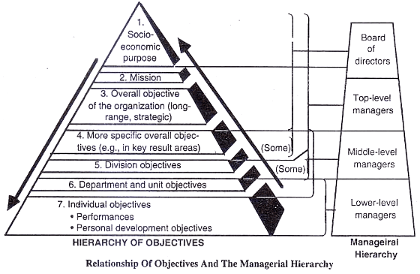
Hierarchy of objectives

Slide 4
Socio-economic purpose of TCS
“Our company believes that corporate sustainability extends to the triple bottom line of people, planet, and profit. We have increased the radius of business responsibility beyond immediate benefit to long-term good, while ensuring the sustainability of the organization. TCS enables an environment of greater consciousness through a process of collaboration with employees, suppliers, customers, and the community at large”.

Slide 5
Mission of TCS
TCS Technology will provide products and services that not only meet but exceed the expectation of our customers through planned and continuous improvement of our Services, Products, Processes and People.

Slide 6
Objectives of TCS
TCS serves large and fast-growing organizations who share a common set of objectives: Increase profitability and efficiency by doing more with less and effectively respond to the changing market demands, thereby improving organizational agility, Use IT to maximum advantage as a strategic driver for competitive advantage, not just as a business utility.

Slide 7
Key Result Areas
The key vertical clusters are: Banking, Financial Services & Insurance (BFSI), Retail and Consumer Business, Communication Media and Technology (CMT), Manufacturing, Travel, Transportation and hospitality.

Slide 8
Division objectives
Objectives of Banking and financial services of TCS:
We enable digital transformation with an innovative suite of financial solutions, which include mobile-based applications, banking-specific RPA components, web-based debt management, and fraud management solutions, among other services.

Slide 9
Departmental/Unit Objectives
Mobile based applications:
"We envision apps to supplant browser-based interfaces — not just on mobile phones, tablets, kiosks, IoT-connected devices, but also on desktop PCs in a single code base. The vision for BaNCS ADK is to transfer flexibility and speed of development to the Bank, leveraging a library of business aware financial widgets and components."

Slide 10
Individual Objectives
Android SDK with development experience in a medium to complex application enterprise/consumer mobile application, Google Play Frameworks,etc.,

Slide 11
An objective is verifiable when at the end of the period, one can determine whether or not it has been achieved.

Slide 12
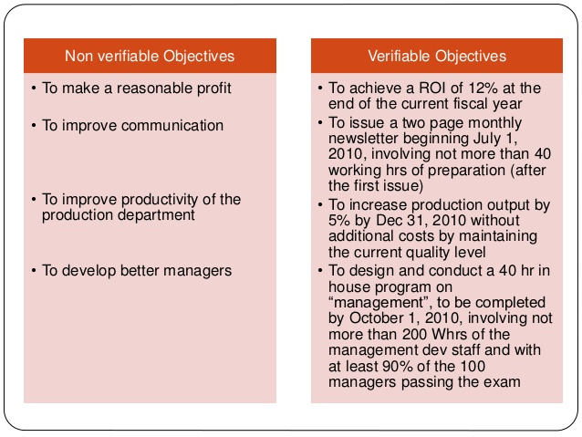
How to set Objectives

Slide 13
Guidelines for setting objectives
Do the Objectives cover the main features of my job?
Is the list of objectives too long? If so can I combine some objectives?
Are the objectives verifiable, that is, will I know at the end of the period whether they have been achieved?

Slide 14
Do the objectives indicate:
Quantity (how much)?
Quality(how well, or specific characteristics)?
Time(when)?
Cost(at what cost)?

Slide 15
Are the objectives challenging yet reasonable?
Are priorities assigned to the objectives(ranking,weight etc.,)?
Have I communicated the objectives to all those who need to be informed?
Are the objectives expressed clearly, and are they in writing?
Do the objectives provide for timely feedback so that I can take any necessary corrective steps?

Slide 16
Are my resources and authority sufficient for achieving the objectives?
Have I given the individuals who are expected to accomplish the objectives a chance to suggest their objectives?
Do my subordinates have control over the aspects for which they are assigned responsibility?

Slide 17
Management by Objectives(MBO)
Management by objectives (MBO) is a model that aims to improve the performance of an organization by clearly defining objectives that are agreed to by both management and employees.
According to the theory, having a say in goal setting and action plans encourages participation and commitment among employees, as well as aligning objectives across the organization.

Slide 18
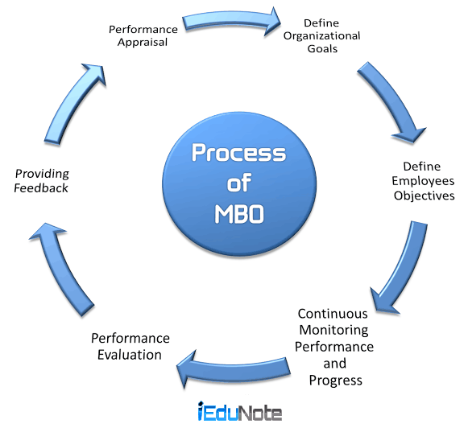
Process of MBO

Slide 19
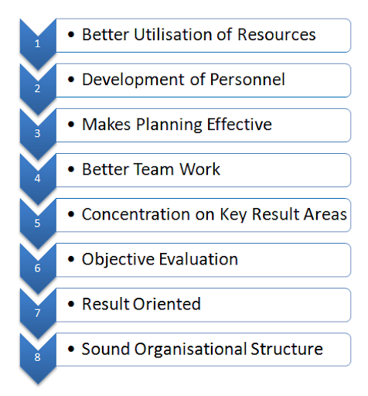
Benefits of MBO

Slide 20
Failures of MBO
Failure to Teach MBO Philosophy(Self control and self-direction)
Failure to Give Guidelines to Goal setters
Difficulty in Setting Verifiable Goals
Emphasis on Short Term Objectives
Danger of Inflexibility

